Slide 1



UNIT 5; Tick tock
Lesson 5; In our time

Slide 2
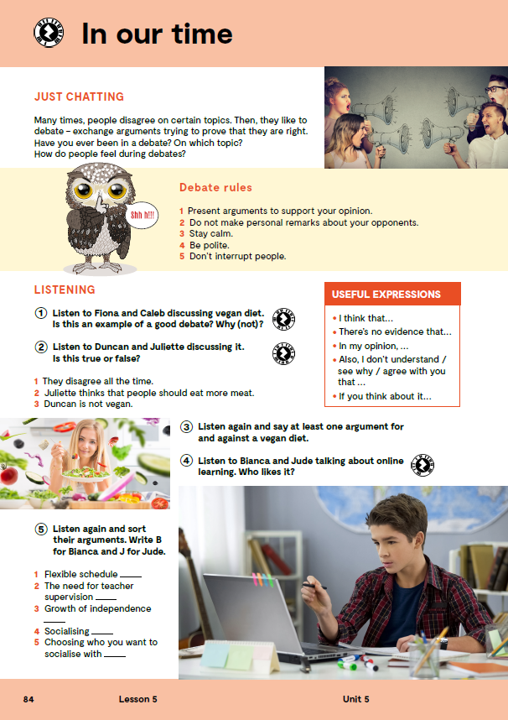
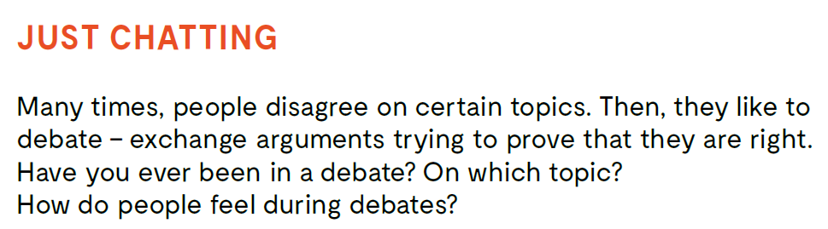
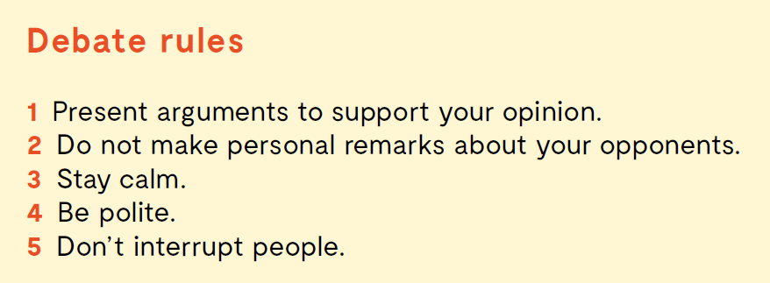
Many times, people disagree on certain topics. Then, they like to debate – exchange arguments trying to prove that they are right.
Have you ever been in a debate? Which topic?
How do people feel during debates?
Do you know the meaning of these expressions?
argument
opinion
agree
disagree
argument
mišljenje
slagati se
ne slagati se
DEBATE RULES
1 Present arguments to support your opinion.
2 Do not make personal remarks about your opponents.
3 Stay calm.
4 Be polite.
5 Don’t interrupt people.

Slide 3
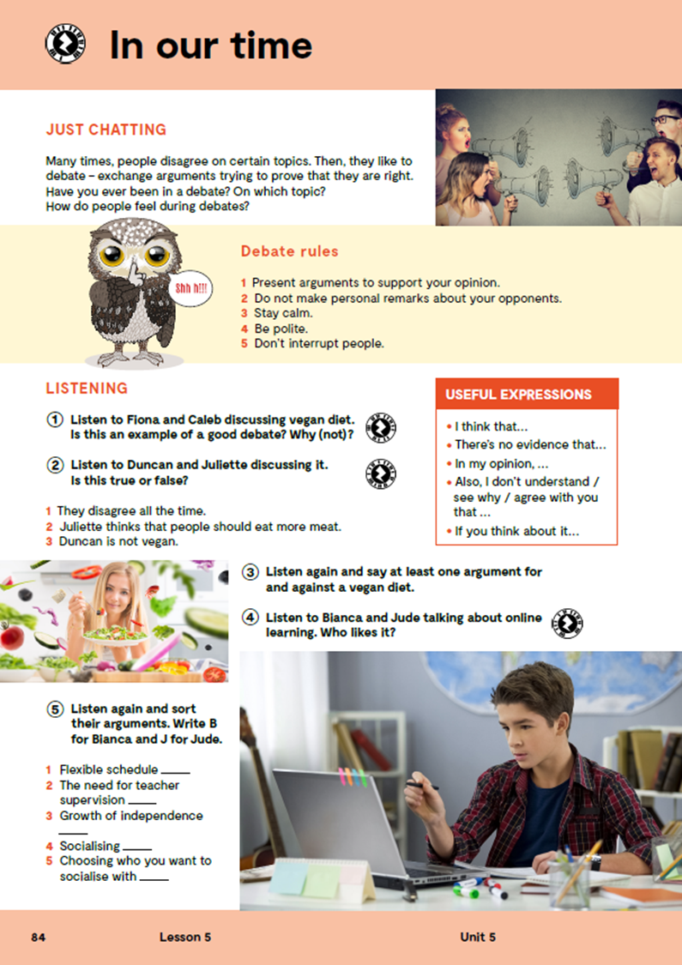


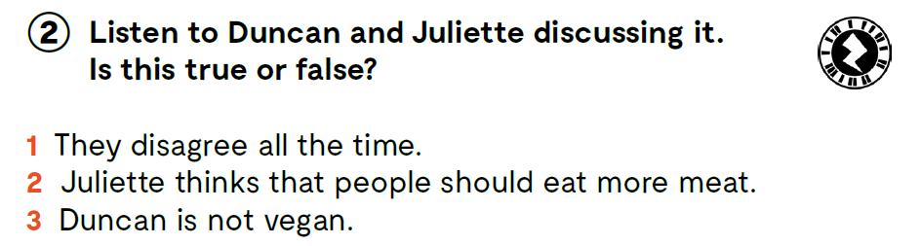
Listen to Fiona and Caleb discussing vegan diet. Is this an example of a good debate? Why (not)? https://www.e-sfera.hr/dodatni-digitalni- sadrzaji/45c78625-3f81-490e-b37c-11170cc2ed0a/assets/audio/18_unit_5__lesson_5__exercise_1.mp3
Listen to Duncan and Juliette discussing it. Is this true or false? https://www.e-sfera.hr/dodatni-digitalni-sadrzaji/45c78625-3f81-490e-b37c-11170cc2ed0a/assets/audio/19_unit_5__lesson_5__exercise_2.mp3
F
F
T

Slide 4
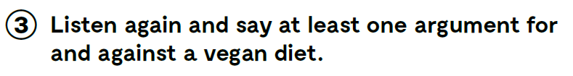
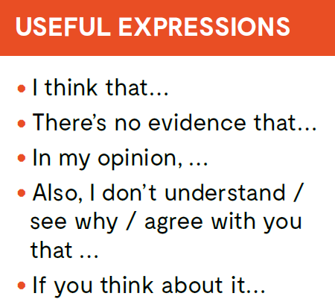
Listen again and say at least one argument for and against a vegan diet.
USEFUL EXPRESSIONS https://www.e-sfera.hr/dodatni-digitalni-sadrzaji/45c78625-3f81-490e-b37c-11170cc2ed0a/assets/audio/19_unit_5__lesson_5__exercise_2.mp3

Slide 5
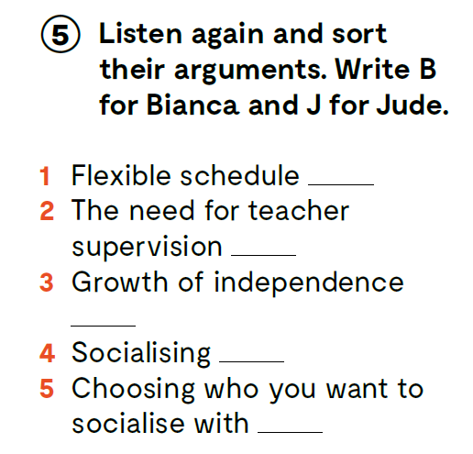
Listen to Bianca and Jude talking about online learning. Who likes it? https://www.e-sfera.hr/dodatni-digitalni-s adrzaji/45c78625-3f81-490e-b37c-11170cc2ed0a/assets/audio/20_unit_5__lesson_5__exercise_4-6.mp3
Listen again and sort their arguments. Write B for Bianca and J for Jude. https://www.e-sfera.hr/dodatni-digitalni-sadrzaji/45c78625-3f81-490e-b37c-11170cc2ed0a/assets/audio/20_unit_5__lesson_5__exercise_4-6.mp3
J
B
J
B
J

Slide 6
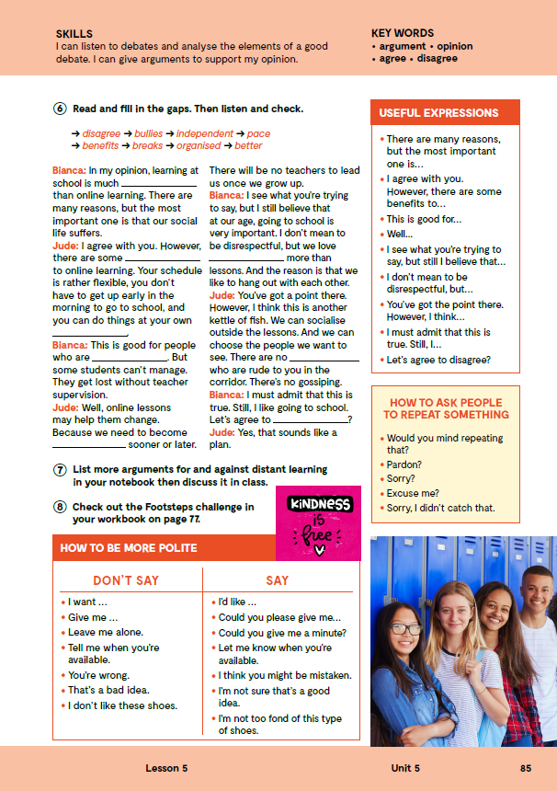
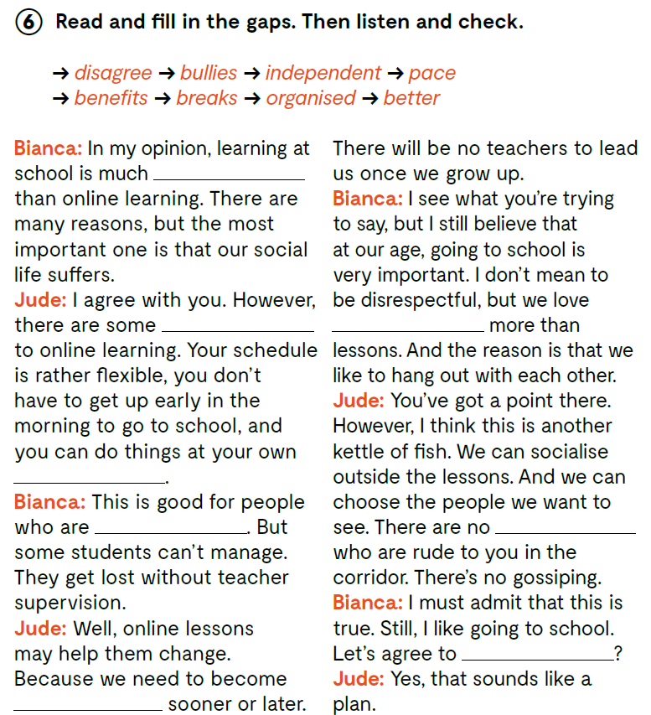
On the next page, page 85.
Read and fill in the gaps. Then listen and check. https://www.e-sfera.hr/dodatni-digitalni-sadrzaji/45c78625-3f81-490e-b37c-11170cc2ed0a/assets/audio/20_unit_5__lesson_5__exercise_4-6.mp3
better
benefits
breaks
pace
organised
bullies
disagree
independent

Slide 7
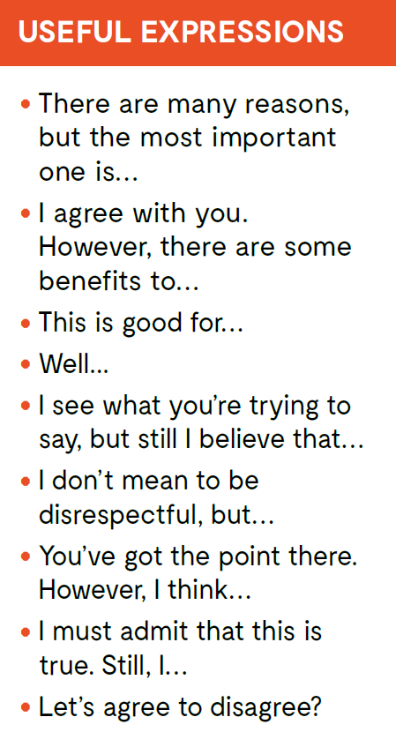

Look at the expressions in the USEFUL EXPRESSIONS box. These expressions can be used in different debates. Try to find them in task 6.
List more arguments for and against distant learning in your notebook.

Slide 8

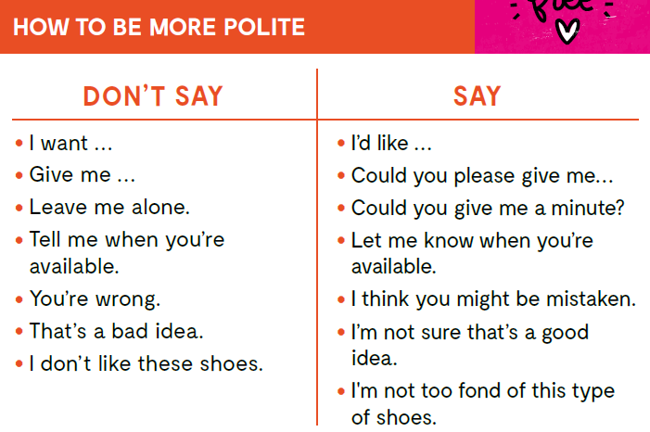
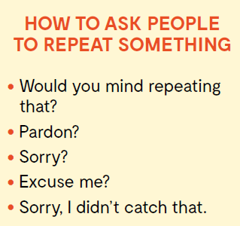
Here are some examples of how to be more polite and how to ask people to repeat something.

Slide 9
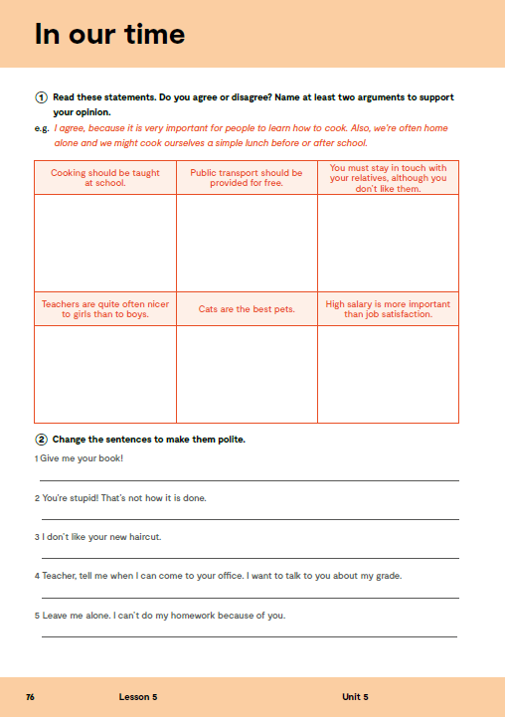
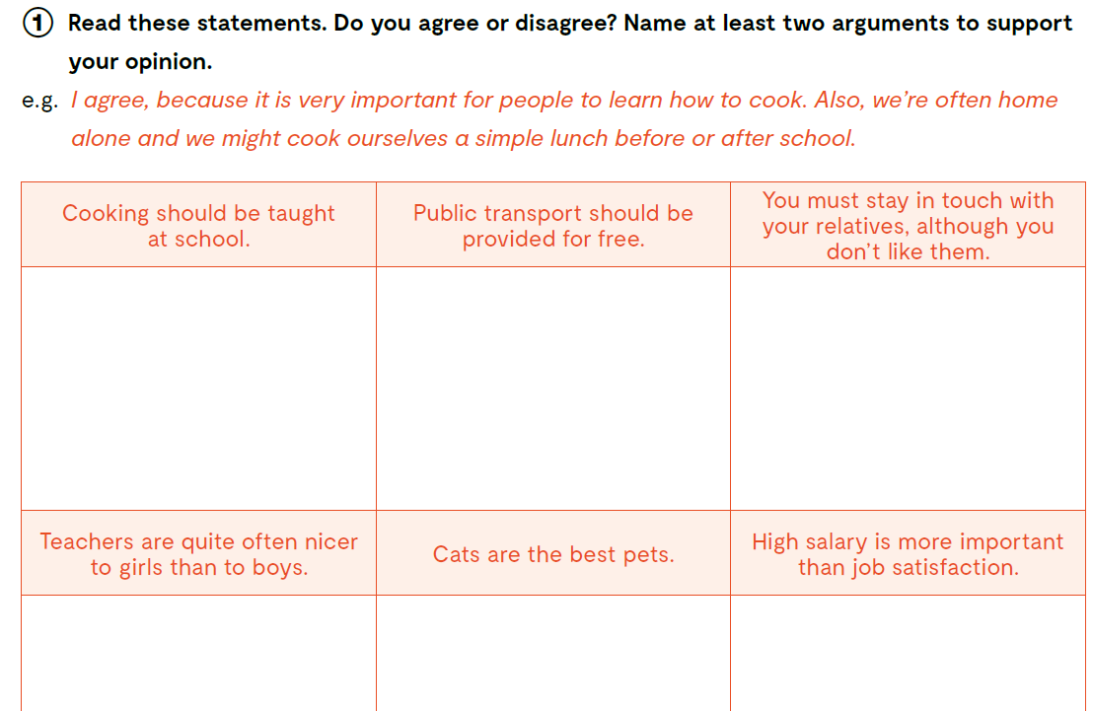
WORKBOOK page 76.
Read these statements. Do you agree or disagree? Name at least two arguments to support your opinion.

Slide 10
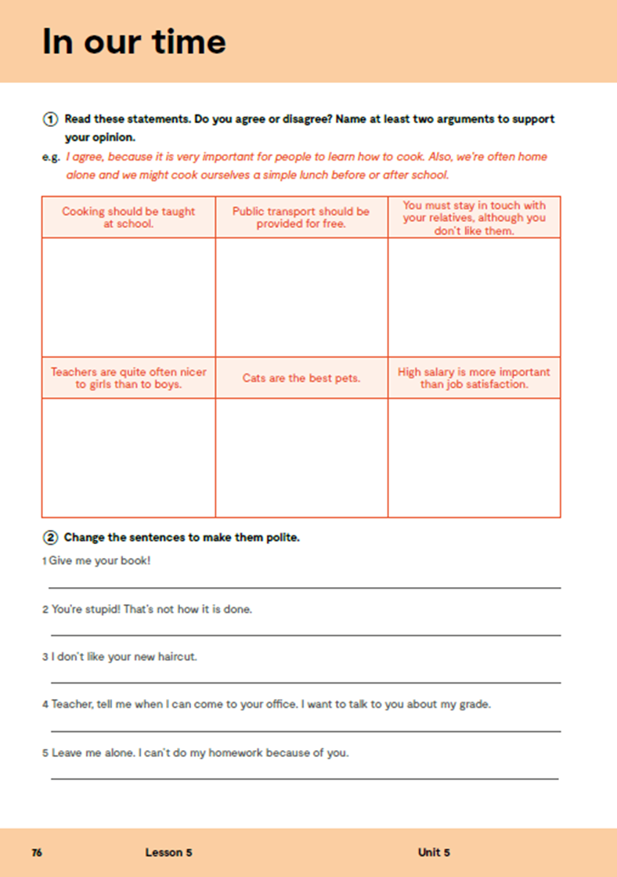
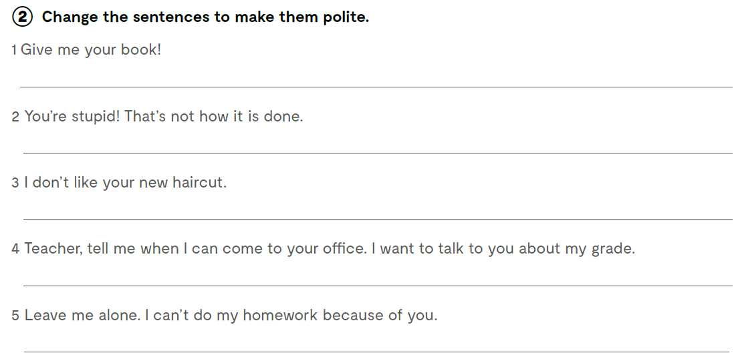
Could I borrow your book, please?
I’m not sure this is right. May I show you how to do it?
I liked your old haircut better.
Teacher, is it possible for me to see you in your office? I would like to talk to you about my grade.
Could you please tell me that later? I need to finish my homework first.
Check what you have learnt. https://wordwall.net/play/13085/713/359

